Slide 1
MATSIRO (physics) VISIT-e (BGC)
Matrix approach to CMIP6 and TRENDY
Working group
MIROC-ES2L
Assignment week 6-7-21
Kostiantyn Viatkin
Gurveen Arora

Slide 2
Description of a model
MATSIRO (physics), VISIT-e (biogeochemistry) - MIROC ESM
Model name
Lead PI or contact person and her/his affiliation.
Static or dynamic vegetation
Number of plant functional types
What disturbances are simulated (e.g., land use or fire etc.)?
Number of pools
How are pools connected? (i.e., carbon flow diagram)
Outputs for CMIP6 or TRENDY
T. Hajima (MIROC), K. Takata (MATSITO), A. Ito, E. Kato (VISIT-e)
static biome distribution + LUC: deforestation/afforestation, etc.
12 + cropland
LUC, fire, agriculture, etc.
3-6 live C pools; 2-6 dead C pools
see next slides
see next slides

Slide 3
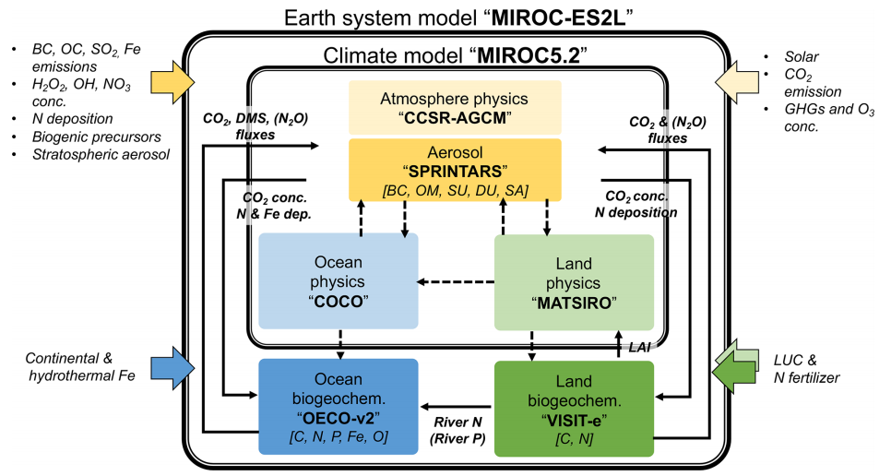
MIROC-ES2L
Model for Interdisciplinary Research on Climate, Earth System version 2 for Long-term simulations
Lead PI: Tomohiro Hajima (hajima@jamstec.go.jp)
Research Institute for Global Change, Japan Agency for Marine-Earth Science and Technology, Showamachi, Kanazawaku, Yokohama, Japan
Hajima et al. (2020) developed MIROC-ES2L by incorporating biogeochemical processes into MIROC general circulation model for atmospheric and oceanic physical processes
Land components:
MATSIRO provides soil moisture data to VISIT-e.
VISIT-e provides leaf area index (LAI) data to MATSIRO
Hajima et al. (2020) https://doi.org/10.5194/gmd-13-2197-2020

Slide 4
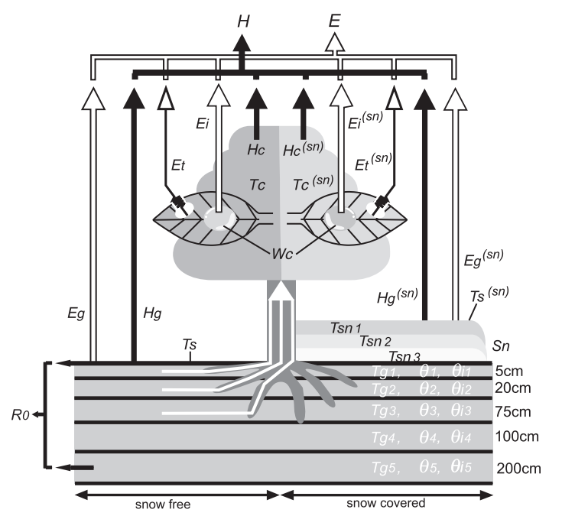
MATSIRO
Minimal Advanced Treatments of Surface Interaction and Runoff
Lead PI: Kumiko Takata (takata@jamstec.go.jp)
MATSIRO consists of two parts:
LNDFLX – determination of parameters and surface fluxes
LNDSTP – ground processes
Frontier Research System for Global Change, Showa-machi, Kanazawa-ku, Yokohama, Japan
H - heat fluxes;
E - water fluxes (evaporation/transpiration);
T - temperatures
Inputs:
wind velocity,
atm. temperature, humidity, pressure
downward radiation,
rainfall, snowfall
Prescribed parameters:
with horizontal distribution: LAI, albedo, slope
with land cover type: canopy parameters
with soil type: porosity, heat and moisture capacity and conductivity
LNDFLX Output:
heat fluxes
water fluxes
wind stress
surface temperature
canopy temperature
LNDSTP Output:
soil temperature
soil moisture / frozen soil moisture
runoff
snow water, temperature, albedo
K. Takata et al. (2003) https://doi.org/10.1016/S0921-8181(03)00030-4

Slide 5
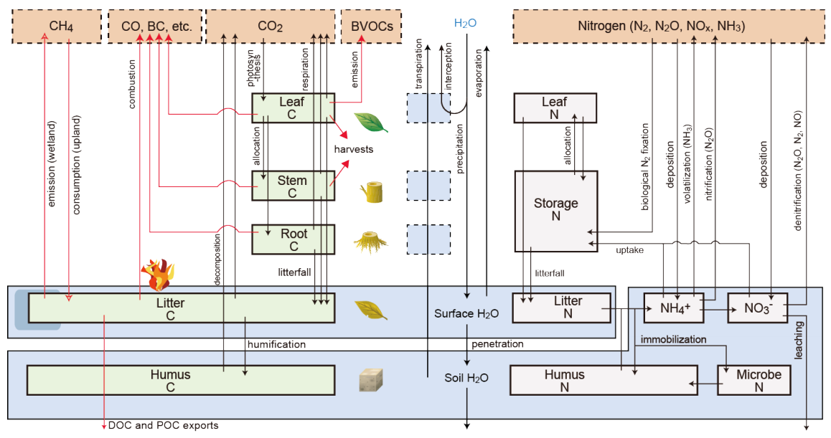
VISIT-e
Vegetation Integrative Simulator for Trace gases
Lead PIs: Akihiko Ito (itoh@nies.go.jp)
National Institute for Environmental Studies (NIES), Japan
Etsushi Kato (e-kato@iae.or.jp)
Research Institute for Global Change, JAMSTEC, Yokohama, Japan
NPP is partitioned to the 6 plant C pools on the basis of production optimization and allometric constraints
From each vegetation C pool, a certain fraction of C is transferred to the soil litter pool, which has a specific turnover rate or residence time representing the decomposition of litter C into soil humus and eventually CO2.
The C stored in litter (i.e., foliage, stem, and root litter) and humus (i.e., active, slow, and passive) pools is decomposed and released as CO2 into the atmosphere under the influence of soil water and temperature.
A. Ito (2019) https://doi.org/10.5194/esd-10-685-2019

Slide 6
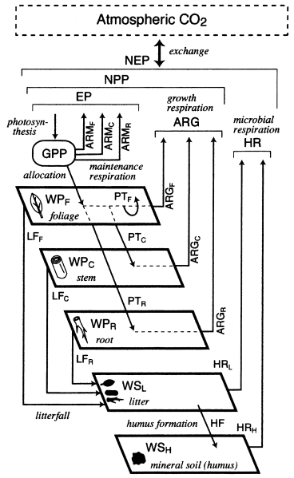
Sim-CYCLE
A. Ito, T. Oikawa (2002) https://doi.org/10.1016/S0304-3800(01)00473-2
5 compartments:
foliage (WPF);
stem and branch (WPC);
root (WPR);
litter or dead biomass (WSL);
mineral soil or humus (WSH).
Carbon fluxes among the compartments:
include gross primary production (GPP),
maintenance respiration (ARM),
translocation (PT),
growth respiration (ARG),
litterfall (LF):
foliage
stem and branch
root
soil heterotrophic respiration (HR).
?
C3 / C4 ?
3 C3 pools
3 C4 pools
3 litter pools?
WSL
3 soil pools?
foliage litter
?
stem litter
active
WSH
?
root litter
slow
?
passive

Slide 7
Probable C flow diagram for CMIP6
Based on the description in V. Arora et al. (2020) https://doi.org/10.5194/bg-17-4173-2020
growth respiration
NPP
GPP
maintenance respiration
allocation
leaf
stem
root
litterfall
leaf
litter
stem
litter
root
litter
heterotrophic respiration
humus formation
active SOM
intermediate SOM
humus
passive SOM

Slide 8
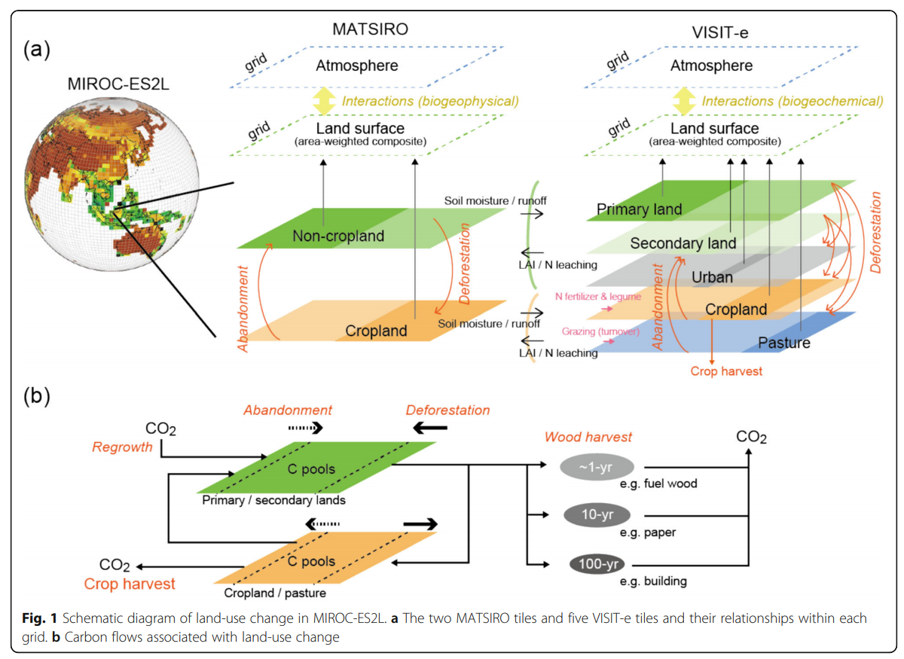
Land use in MATSIRO and VISIT-e
MATSIRO model has 2 separate layers: one for natural ecosystems and another for croplands.
VISIT-e model has 5 land use layers: primary, secondary, urban, cropland and pasture.
Almost all biogeochemical processes are simulated separately in the 2 (or 5) layers and then weighted by their respective areas to obtain mean values for each grid cell.
A transitional change in the fractions of natural ecosystems and cropland, associated with land-use conversion, results in interactions between the layers
A. Ito, T. Hajima (2020) https://doi.org/10.1186/s40645-020-00372-w

Slide 9
Plant Functional Types (biomes) in VISIT-e
In CMIP 6 Vegetation types for VISIT-e are based on MODIS vegetation cover categories:
1 = evergreen needleleaf forest,
2 = evergreen broadleaf forest,
3 = deciduous needleleaf forest,
4 = deciduous broadleaf forest,
5 = mixed forest,
6 = closed shrubland,
7 = open shrubland,
8 = woody savanna,
9 = savanna,
10 = grassland,
11 = permanent wetland
12 = desert
Cropland is simulated as one of the model tiles, the areal fraction of which follows CMIP6 35 forcing (LUH2 (Ma et al., 2019); http://luh.umd.edu )

Slide 10
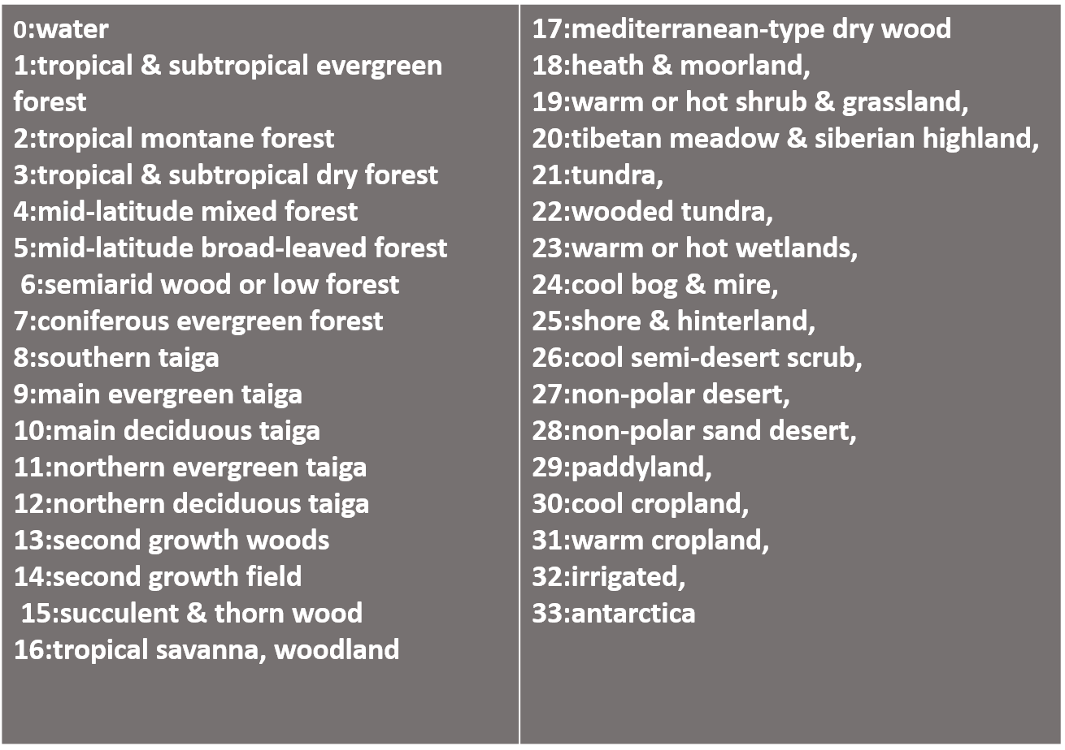
Biomes in VISIT used in ISIMIP

Slide 11
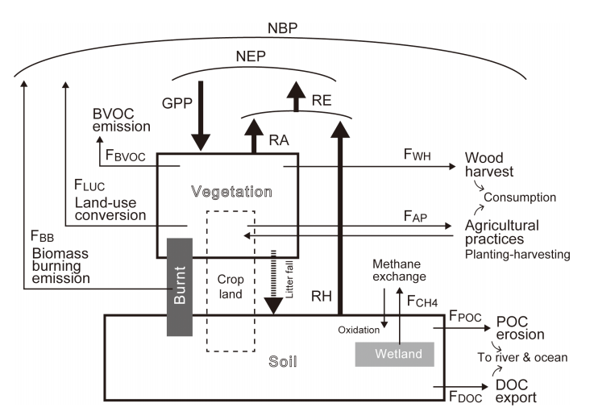
Disturbances in VISIT
8 minor carbon flows included in the VISIT model:
emissions associated with land-use change (FLUC),
biomass burning by wildfire (FBB),
emission of biogenic volatile organic compounds or biogenic volatile organic compounds (BVOCs) (FBVOC),
methane emissions from wetlands and methane oxidation in uplands (FCH4 ),
agricultural practices from cropping to harvesting (FAP),
wood harvesting in forests (FWH),
export of dissolved organic carbon (DOC) by rivers (FDOC),
displacement of soil particulate organic carbon (POC) by water erosion (FPOC).
A. Ito (2019) https://doi.org/10.5194/esd-10-685-2019

Slide 12
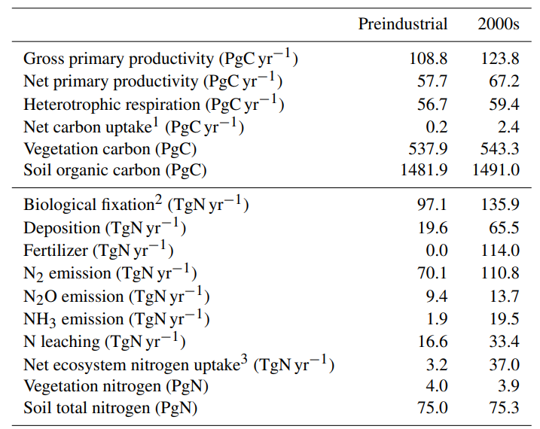
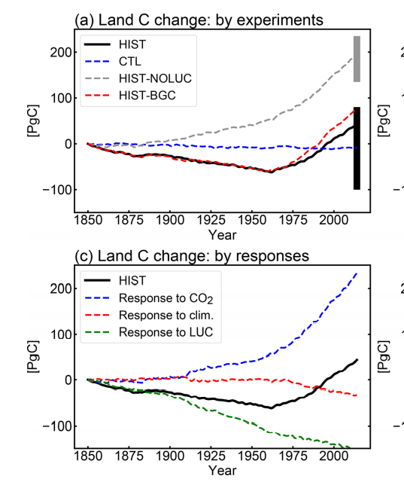
Outputs for CMIP 6
1pct-bgc
178.7
97.9
89.4
7.2
918.3
2013.2
103.8
19.6
0
55
5.8
1.1
8.6
35.7
3.6
78.5
Hajima et al. (2020) https://doi.org/10.5194/gmd-13-2197-2020

Slide 13
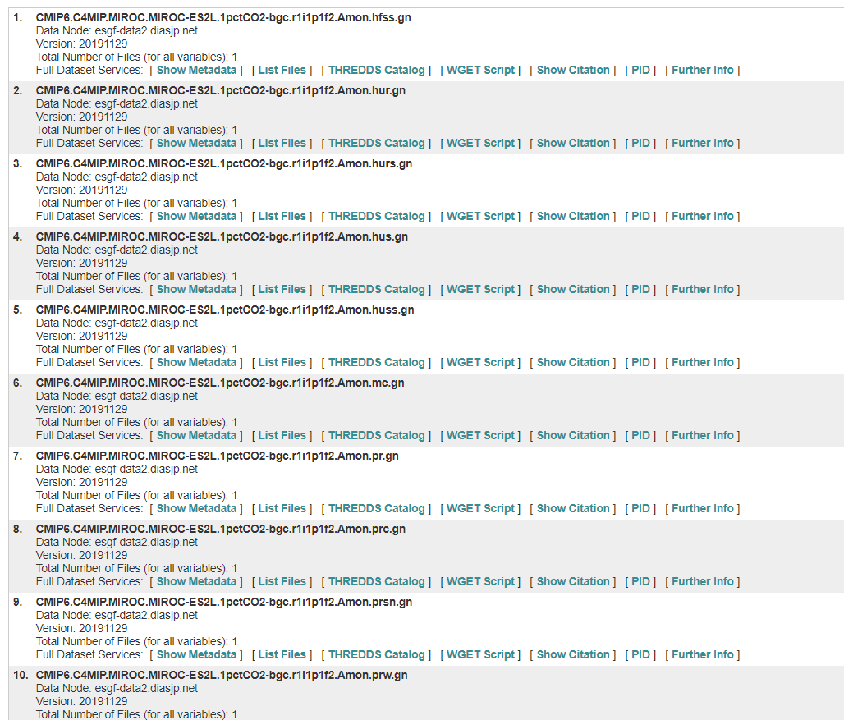

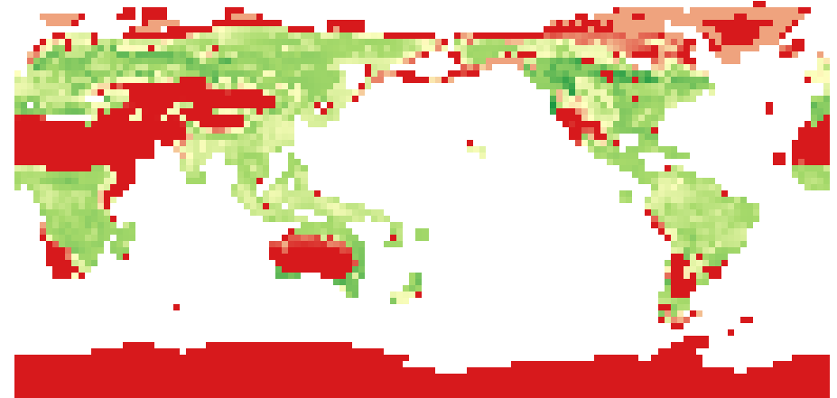
Outputs for CMIP 6
NetCDF files with 1800 layers each - monthly values 1850-2000.
total of 64 files for land realm in 1%CO2-bgc, including C and N cycles
https://esgf-node.llnl.gov/projects/cmip6/

Slide 14
Outputs for CMIP 6 - 1%CO2-bgc
growth respiration
NPP
C pools:
GPP
maintenance respiration
total_carbon_in_all_terrestrial_carbon_pools
carbon_mass_in_leaves
carbon_mass_in_roots
carbon_mass_in_litter_pool
carbon_mass_in_above-ground_litter
carbon_mass_in_below-ground_litter
carbon_mass_in_soil_pool
carbon_mass_in_fast_soil_pool
carbon_mass_in_medium_soil_pool
carbon_mass_in_slow_soil_pool
total C
allocation
plant pools
leaf
stem
root
litterfall
leaf
litter
stem
litter
root
litter
litter pools
heterotrophic respiration
humus formation
active SOM
soil pools
intermediate SOM
humus
passive SOM

Slide 15
Outputs for CMIP 6 - 1%CO2-bgc
C fluxes:
growth respiration
NPP
surface_net_downward_mass_flux_of_carbon_dioxide_expressed_as_carbon_due_to_all_land_processes
C_mass_flux_out_of_atmosphere_due_to_gross_primary_production_on_land
C_mass_flux_out_of_atmosphere_due_to_net_primary_production_on_land
C_mass_flux_into_atmosphere_due_to_autotrophic_(plant)_respiration_on_land
C_mass_flux_into_atmosphere_due_to_growth_autotrophic_respiration_on_land
C_mass_flux_into_atmosphere_due_to_heterotrophic_respiration_on_land
C_mass_flux_into_atmosphere_due_to_maintenance_autotrophic_respiration_on_land
C_mass_flux_due_to_npp_allocation_to_leaf
C_mass_flux_due_to_npp_allocation_to_roots
C_mass_flux_due_to_npp_allocation_to_wood
total_C_mass_flux_from_vegetation_to_litter
C_mass_flux_into_soil_from_litter
net flux
GPP
maintenance respiration
allocation
GPP, NPP
leaf
stem
root
litterfall
respiration
leaf
litter
stem
litter
root
litter
heterotrophic respiration
humus formation
active SOM
plant allocation
intermediate SOM
humus
passive SOM
C transfer

Slide 16
VISIT Model in TRENDY
VISIT Model is part of TRENDY project of intercomparison of models informing the carbon budget activities in global carbon
project. The first version of the TRENDY project started in 2011 with 9 models and in 2018, 14 models are included.
As the name suggests, VISIT Model simulate fluxes of trace gases based on carbon and nitrogen cycle among vegetation,
soil, and atmosphere. The spatial resolution used is 0.5º ×0.5º grid cells. The temporal resolution is annual for LUC and CO₂ and other climate variables is taken on monthly basis.
This model examines the affect on Gross Primary productivity (GPP) seasonally with CO₂ fertilization. In TRENDY vegetation project,
Emissions associated with land-use change (FLUC),
Biomass burning by wildfire (FBB),
Emission of biogenic volatile organic compounds or biogenic volatile organic compounds
(BVOCs) (FBVOC),
4. Methane emissions from wetlands
Methane oxidation in uplands (FCH4 ),
Agricultural practices from cropping to harvesting (FAP),
Wood harvesting in forests (FWH), export of dissolved organic carbon (DOC) by rivers (FDOC),
Displacement of soil particulate organic carbon (POC) by water erosion (FPOC).
Vertical exchange with atmosphere
Lateral flow due to water and human activities
Burning of debris after deforestation (FLUC)
Excludes human-induced ignition (FBB)
MINOR CARBON FLOWS

Slide 17
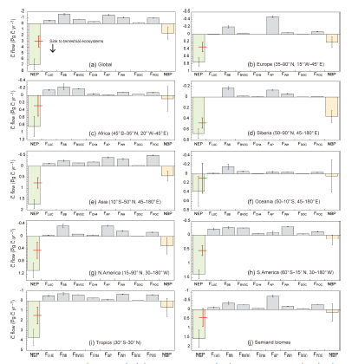
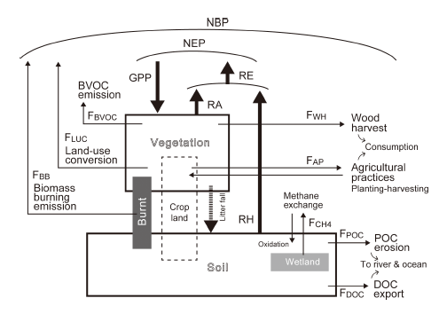
The processes behave differently to determine terrestrial carbon budget from GPP,NEP, NPP and RH (major carbon flows)
denoted as thick lines and Minor carbon flows (thin lines) (A)
Regional terrestrial Carbon Budget using 8 minor carbon flows (B)
(A)
(B)

Slide 18
Global distribution of
simulated MCFs from
2000-2009.

Slide 19
Code and data availability
The code of MIROC-ES2L is not publicly archived because of the copyright policy of the MIROC community. Readers are requested to contact the corresponding author if they wish to validate the model configurations of MIROC-ES2L and conduct replication experiments.
The model outputs are distributed and made freely available through the Earth System Grid Federation (ESGF):
Control (https://doi.org/10.22033/ESGF/CMIP6.5710, Hajima et al., 2019f),
Historical
(https://doi.org/10.22033/ESGF/CMIP6.5602, Hajima et al., 2019d;
https://doi.org/10.22033/ESGF/CMIP6.5582, Hajima et al., 2019e;
https://doi.org/10.22033/ESGF/CMIP6.5496, Hajima et al., 2020),
1%CO2 increase
(https://doi.org/10.22033/ESGF/CMIP6.5376, Hajima et al., 2019a;
https://doi.org/10.22033/ESGF/CMIP6.5378, Hajima et al., 2019b;
https://doi.org/10.22033/ESGF/CMIP6.5370, Hajima et al., 2019c).

Slide 20
Data assimilation for VISITe matrix model reconstruction
K. Viatkin 9/29/2021

Slide 21
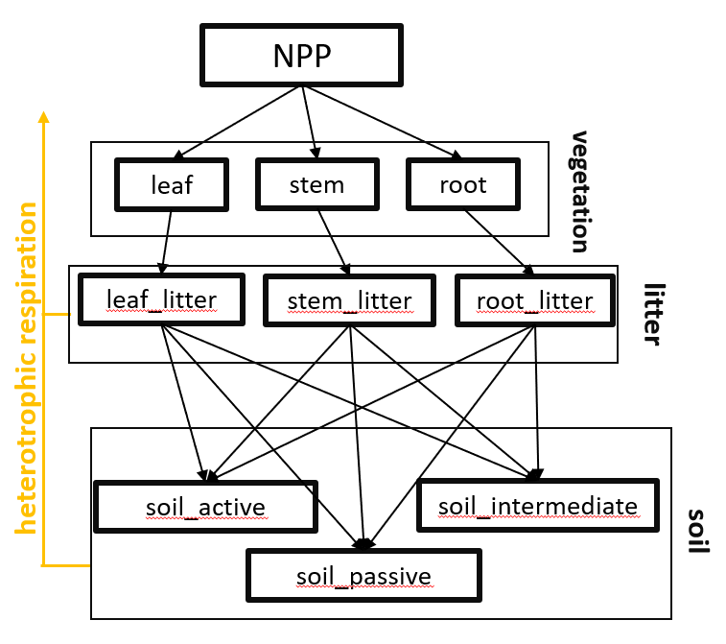
VISIT2 model
Simplified C flow diagram for VISITe:
VISITe is a land biogeochemical part of the MIROC ESM developed by Japan Agency for Marine-Earth Science and Technology (JAMSTEC) and Centre for Climate System Research / National Institute for Environmental Studies, Japan
Its version for the CMIP6 includes 9 C pools
Model includes:
dynamic leaf allocation depending on optimal LAI,
dynamic leaf fall depending on temperature (deciduous forest)
dynamic soil respiration depending on soil temperature and soil moisture

Slide 22
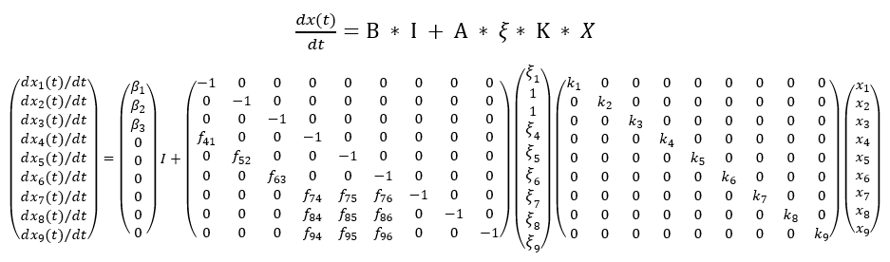
VISITe (simplified*) - matrix format
B (β₁ – β₃) – allocation coefficients to vegetation pools (leaf, stem, root)
A (f₄₁ – f₉₆) – transfer coefficients between C pools (leaf, stem, root)
ξ – dynamic environmental modifiers for turnover rates
ξ₁ – leaf pool modifier for deciduous forest – starts and stops leaf fall depending on air temperature
ξ₄₋₉ – turnover modifiers for litter and soil pools depending on soil temperature and soil moisture
K (k₁ – k₉) – base turnover rates for all C pools
X (x₁ – x₉) – C pools
* no dynamic leaf allocation

Slide 23
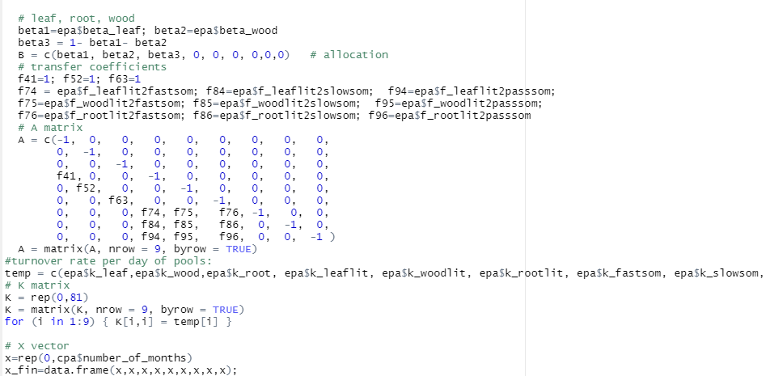
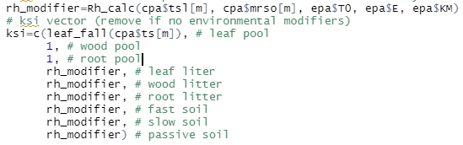
Defining B (β₁ – β₃)
Defining A (f₄₁ – f₉₆)
Defining K (k₁ – k₉)
Defining X (x₁ – x₉)
Defining ξ

Slide 24
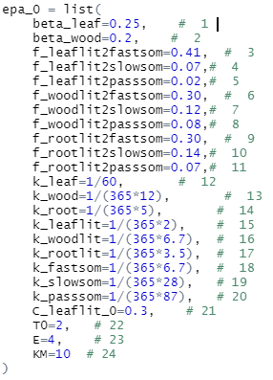
VISITe parameters reconstruction based on CMIP6 output
Unknown model parameters:
Allocation coefficients
Transfer coefficients
Turnover rates for all pools
Initial leaf litter pool size
Parameters of dynamic turnover modifier equation
I assigned arbitrary (but reasonable) values for the unknown model parameters and specified possible maximum and minimum values (prior range) for them.

Slide 25
CMIP6 output vs model output
CMIP6 output allows to compare matrix model performance with the following indicators:
C_leaf
C_wood
C_root
C_litter_above
C_litter_below
C_fastsom
C_slowsom
C_passsom
rh,
f_veg2litter
f_litter2som
I set matrix model to give same output to compare results and optimize parameters.

